Slide 1


Daria Solodey
Methodist, course creator

Slide 2
Goal:
pass a job interview
Class rules:
Turn on your camera
Set up your microphone
Be active
Notes:
Если вам не хватило места, вы можете здесь написать развернутый комментарий.

Slide 3
Choose any number from 1 to 3.
1 2 3

Slide 4
This number is a number of facts that you have to say about yourself.
1 2 3

Slide 5

Lesson Plan:
Study how to answer the question: “Tell me about yourself”
Discuss the reasons why people fail job interviews
Notes:
Развернутый комментарий.

Slide 6


Look at Jack. Why is he so excited? Look at the pictures and find out the reason. Describe his day.

Slide 7
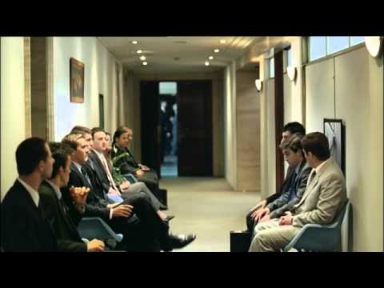
Why do you think some people fail their job interviews?
Have you ever failed your job interviews? Why?
Watch the video. Is it a good way to get a job?
Would it actually work in real life?

Slide 8
Share your ideas on how to succeed at a job interview
Dos Don’ts
Greet the interviewer Take phone calls
__________________ __________________
__________________ __________________
__________________ __________________
__________________ __________________
__________________ __________________
__________________ __________________
__________________ __________________
__________________ __________________
__________________ __________________

Slide 9
Share your tips on how to avoid these situations.
Which reasons from this list do you consider the worst? Why?
5 top reasons why people fail job interviews
Being late for the interview
Tip: be on time
Inappropriate appearance
Inability to communicate clearly
Absence of planning and goals
Showing no enthusiasm and confidence

Slide 10


Slide 11
Before we watch the video, let’s practise the new words
Bachelor’s degree
Master’s Degree
To take the path of
Bold career shift
Endorsed by
To have a great enthusiasm for
Brave changing the type of job or profession you’ve been doing
Given one's public approval or support
A degree that is given to a student by a college or university usually after one or two years of additional study
To feel intense and eager enjoyment, interest
To start your career in a new sphere
A degree that is given to a student by a college or university usually after four years of study

Slide 12
Before we watch the video, let’s practise the new words
Bachelor’s degree
Master’s Degree
To take the path of
Bold career shift
Endorsed by
To have a great enthusiasm for
Brave changing the type of job or profession you’ve been doing
Given one's public approval or support
A degree that is given to a student by a college or university usually after one or two years of additional study
To feel intense and eager enjoyment, interest
To start your career in a new sphere
A degree that is given to a student by a college or university usually after four years of study

Slide 13
Answer the questions. Use the phrases below.
Have you got a bachelor’s degree? If yes, which subject do you have a degree in? If no, would you like to have it?
Have you got a master’s degree? If yes, which subject do you have a degree in? If no, would you like to have it?
Have you ever made a bold career shift? Would you like to make it now?
What did you have a great enthusiasm for when you were child? What do you have a great enthusiasm for now?
5. Have you taken any courses endorsed by high-profile Universities or companies?
6. Are you looking for another job? What job do you want to have?
Use the phrases:
I really feel that…
To my mind…
I guess/believe that…
Let me think…
To be honest...

Slide 14

Watch the video till (1:36-3:31) and answer the questions
Where is Mr Torres? What is he doing there?
What degrees did he complete?
What was his first job? Is it relevant experience?
I there any info that you should skip?

Slide 15
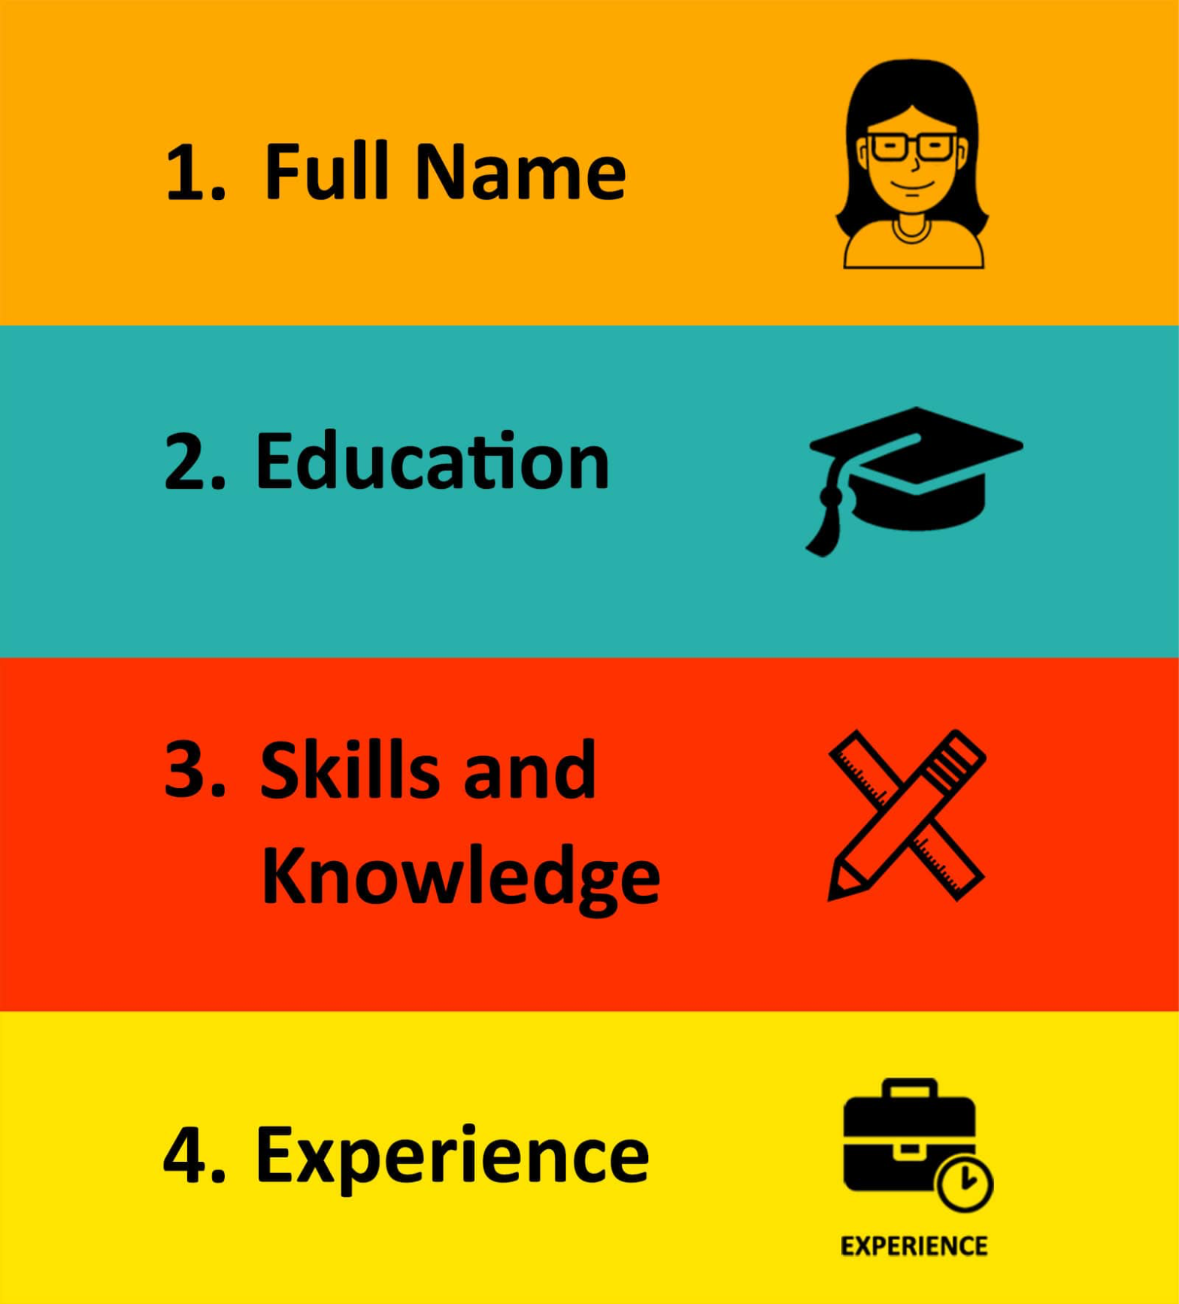
Tell me about yourself
Make a bold career shift
Decide to take the path of
Coming to my skills I know (CSS, Java Script)
I am learning (React)
I did ___successful projects. (you also may describe one of them)
I want to work for you company, because…
Have a great enthusiasm for
Use experience fully
I am a (full-stack developer)

Slide 16
Tell me about yourself
complete a Bachelor’s/Master’s degree in....
manage to get a job in…
make a bold career shift
decide to take the path of…
take courses endorsed by high-profile universities/companies
have a great enthusiasm for…
look for another job
use experience fully

Slide 17

What have you learnt this lesson?
I can:
answer the question: “Tell me about yourself”
understand the reasons why people fail job interviews
Notes:
Развернутый комментарий

Slide 18
Useful links:
Video:
Tell Me About Yourself - Job Interview
Words from this lesson:
Glossary 1

Slide 19
Thank you!

